Slide 1
Mini Google Map
Name: Md. Foysal Mahmud.
Roll: 14CSE028.
Department of Computer Science & Engineering.

Slide 2
Introduction:
This apps first show the user current location whenever the user open this apps. The user can search any place in the world by searching button and see the place marked in Google maps. There are also three option to search automatically nearby place like Hospital, Restaurants And Schools. There also a option to get the distance from user current location.

Slide 3
Apps Technology:
Platform:
Android Studio
Help:
Google API key.
Google Place API key.

Slide 4
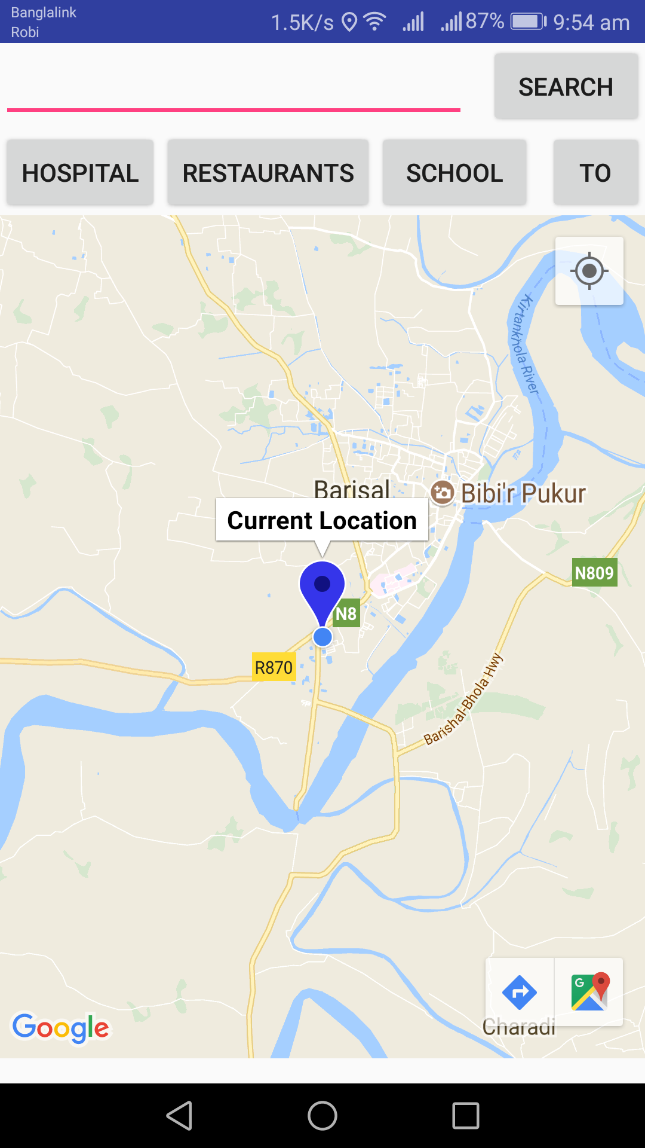
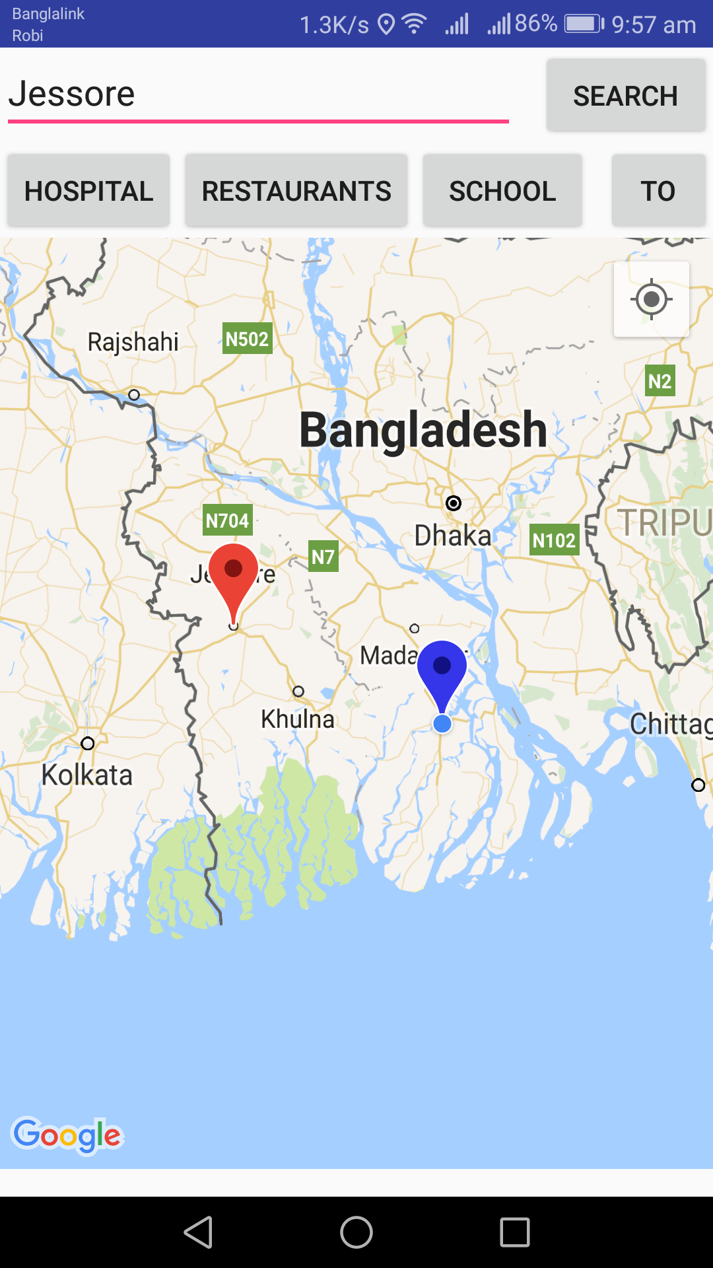
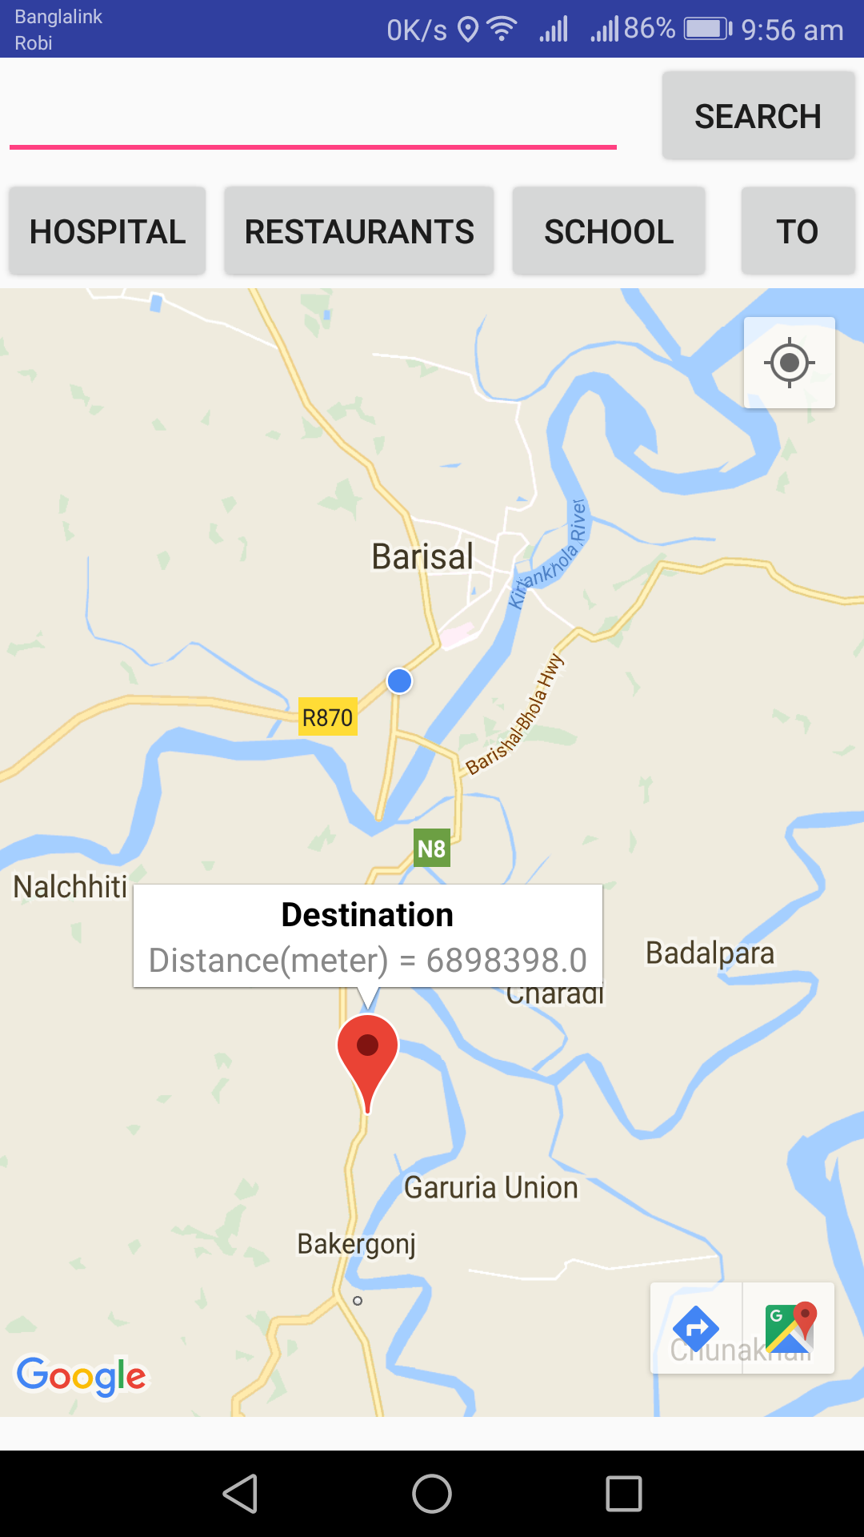
Apps Features:

Slide 5
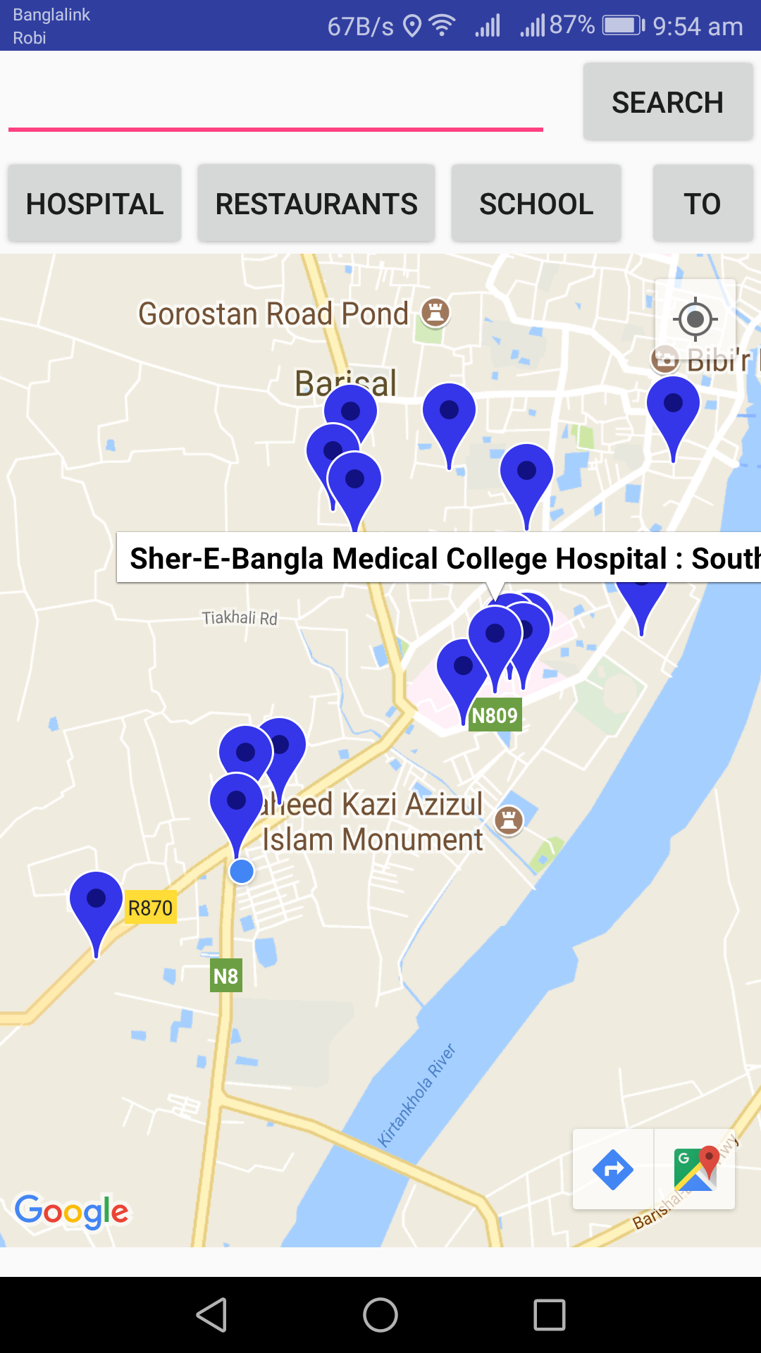
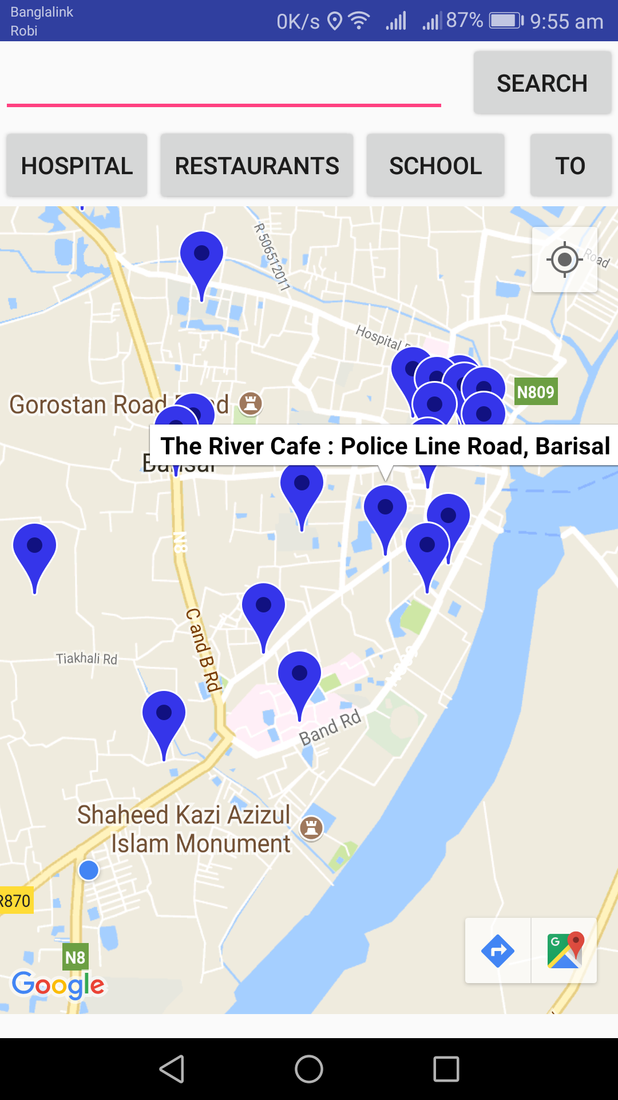
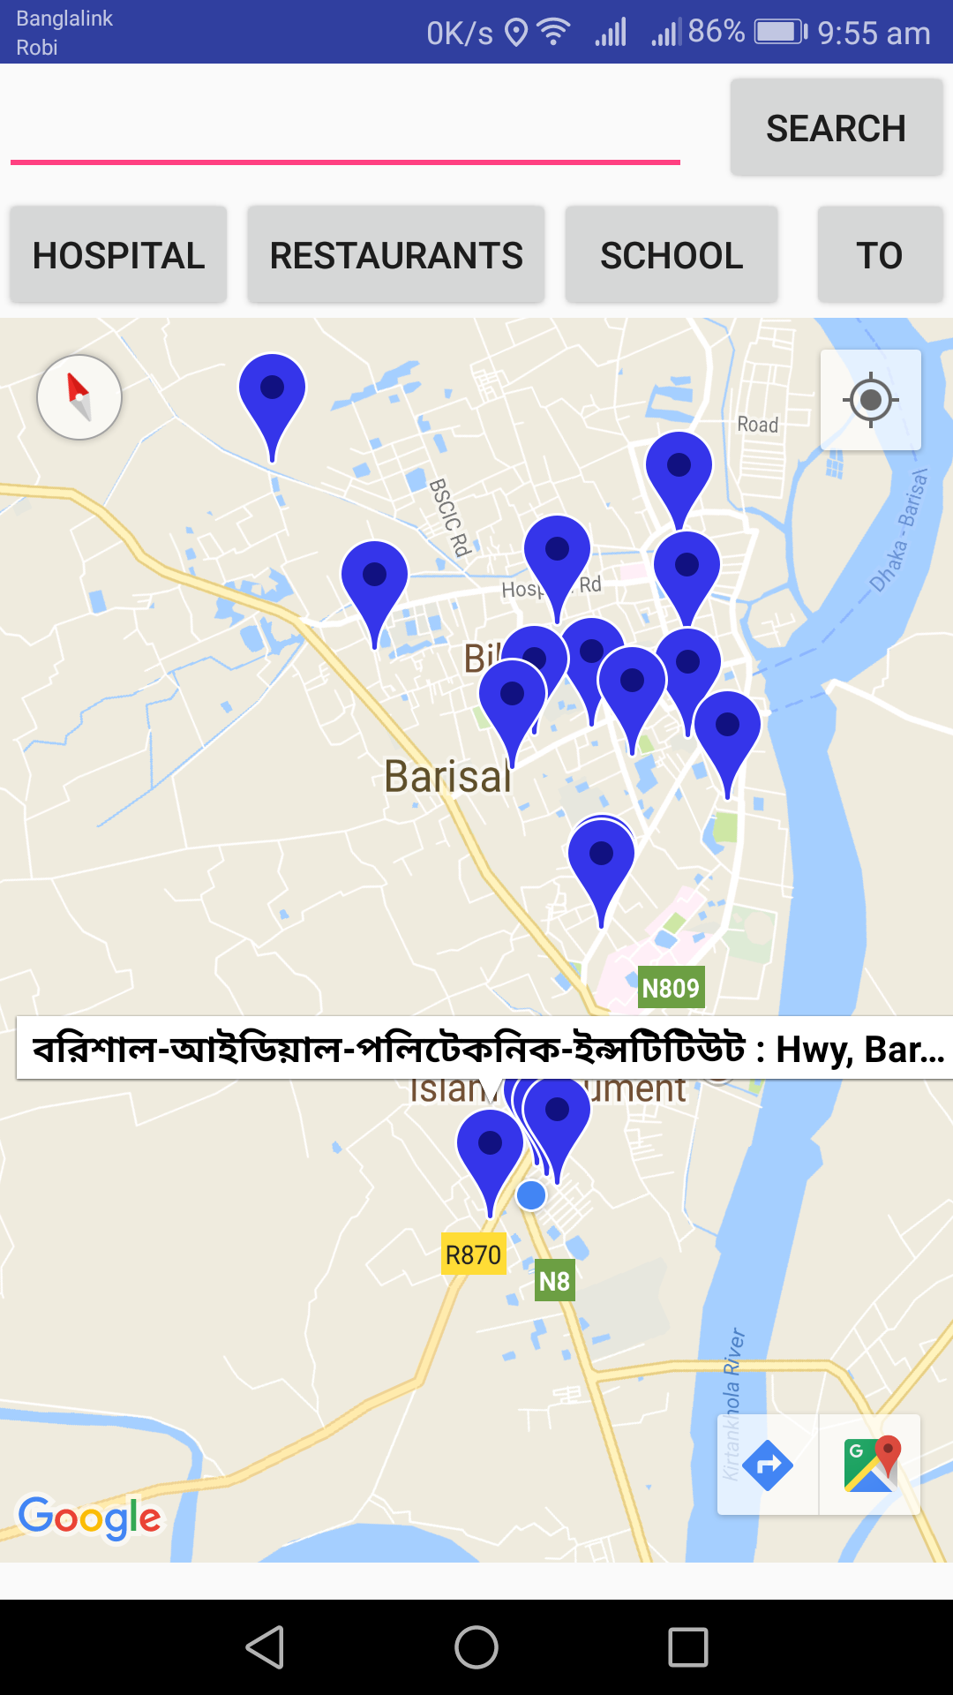
Apps Features:

Slide 6
Simulation of my Project:
Here is a video of My project simulation……….

Slide 7
Conclusion:
The purpose of this project is to implements Google Maps with Android Studio and add some common features to increase knowledge about Google Mapping.
My future purpose is to developed Advanced Google Maps related Android apps.

Slide 8


